Slide 1
Liskov Substitution Principle
Guilherme Menezes

Slide 2
Definition
Liskov
Substitution
Principle
Content:
Introduced by Barbara Liskov
It is a particular definition of subtyping in OO Programming
Based on the idea of substitution
Definition
Example 1
Compliance
Polymorphism
Importance
Example 2
Conclusion

Slide 3
Definition
Liskov
Substitution
Principle
Content:
“If S is a subtype of T, then objects of type T may be replaced with objects of type S without altering the correctness of the program.”
Definition
Example 1
Compliance
Polymorphism
Importance
Example 2
Conclusion

Slide 4
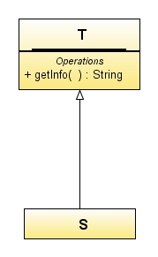
Example
class W {
(..)
void use (T obj) {
String s = obj.getInfo()
}
(..)
}
objW.use(objT)
/* no error is introduced if S is compliant with the principle*/
objW.use(objS)

Slide 5
Compliance
Liskov
Substitution
Principle
Content:
A subclass must keep all the external observable behaviour of its superclass
A subclass may extend the external observable behavior, but never modify it
External observable behaviour
= behaviour of public methods
Definition
Example 1
Compliance
Polymorphism
Importance
Example 2
Conclusion

Slide 6
LSP and Polymorphism
Liskov
Substitution
Principle
Content:
Inclusion Polymorphism
“A subtype can be used where the type is expected.”
The Liskov Substitution Principle helps to guarantee Inclusion Polymorphism
Definition
Example 1
Compliance
Polymorphism
Importance
Example 2
Conclusion

Slide 7
Importance
Liskov
Substitution
Principle
Content:
Inclusion Polymorphism improves
reuse:
All code that references the superclass
can be reused referencing a subclass
Not compliant with LSP
-> No reuse
Definition
Example 1
Compliance
Polymorphism
Importance
Example 2
Conclusion

Slide 8
Importance
Liskov
Substitution
Principle
Content:
Biggest problem:
Programmers that write client modules usually assume Inclusion Polymorphism when writing OO Programs
If we don’t comply with LSP, we may compromise not only reusability, but also correctness!
Definition
Example 1
Compliance
Polymorphism
Importance
Example 2
Conclusion

Slide 9
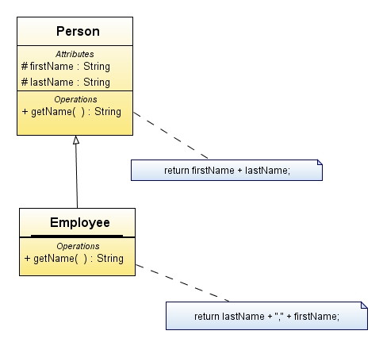
Example
Liskov
Substitution
Principle
Content:
Definition
Example 1
Compliance
Polymorphism
Importance
Example 2
Conclusion

Slide 10
Example
Liskov
Substitution
Principle
Content:
A programmer may write
/*Method to print information about someone on the screen*/
void printInfo(Person obj) { (…)
parser.parseName(obj.getName());
(…) }
Definition
Example 1
Compliance
Polymorphism
Importance
Example 2
expecting this code to work for all subtypes of
“Person”, including “Employee”. This code will
actually result in error.
The redefinition of “getName” changed the behavior
of the method, and introduced an error (or several
errors) in the program.
Conclusion

Slide 11
Conclusion
Liskov
Substitution
Principle
Content:
The LSP is very closely related to:
  Design by Contract
  The Open-Closed Principle.
Together, they form the basic guidelines of
OO Design.
Definition
Example 1
Compliance
Polymorphism
Importance
Example 2
Conclusion

Slide 12
Conclusion
Liskov
Substitution
Principle
Content:
The LSP show us that, during a design, we should
focus on:
  the external behavior of methods and
  assumptions the programmer of client
modules will make.
It also show us a way to use inheritance properly to
achieve reuse and assure correctness.
Definition
Example 1
Compliance
Polymorphism
Importance
Example 2
Conclusion

Slide 13
References
Liskov
Substitution
Principle
Content:
Inclusion polymorphism:
http://courses.cs.byu.edu/cs330/cs330/lectures/lect-31.php
Liskov Substitution Principle:
http://en.wikipedia.org/wiki/Liskov_substitution_principle
http://citeseer.ist.psu.edu/liskov94family.html
http://www.objectmentor.com/resources/articles/lsp.pdf
Open-closed principle:
http://en.wikipedia.org/wiki/Open/closed_principle
Design by contract:
http://en.wikipedia.org/wiki/Design_by_contract
http://www.cs.cofc.edu/~bowring/classes/csci%20360/presentations/Rivera_Carlos_DesignByContract.ppt
Definition
Example 1
Compliance
Polymorphism
Importance
Example 2
Conclusion

